Slide 1
Work Progress Report

Slide 2
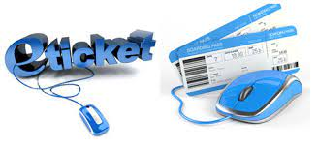
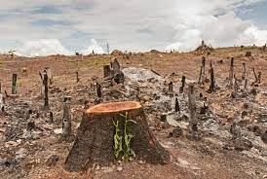

ABSTRACT
Paper describes the opportunities and challenges of e-ticketing
Concept of eticketing is prevalent in the museums, entrance boards, heritage sites
Here we devise a QR based ticketing system with necessary hardware
Along with a best facial recognition based on ticket generation system.

Slide 3
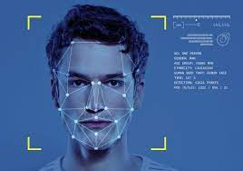
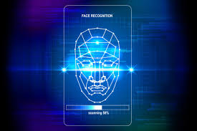
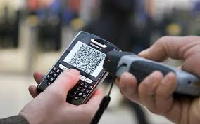
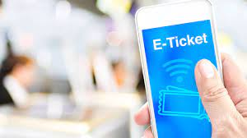
Introduction
E-ticketing in tourism as a “paperless” revolution
Method For Documenting Sale, Tracking Usage And Accounting.
Passenger's visiting without requiring the issue of paper “value documents”
Able to book, pay for and print their e-tickets online from any point
Innovates the ticket generation using facial recognition based ticket generation system.

Slide 4

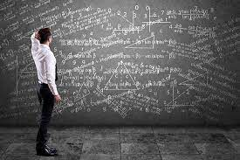

Study Of Existing Systems
Existing system requires more computational time, more manual calculations.
Lack of security of data, deficiency of data accuracy, time consuming etc.
The working more accurately the system needs to be computerized.
More manual work is required therefore increases uneven human work.

Slide 5

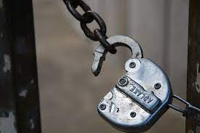
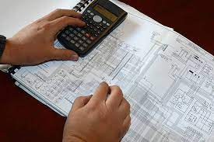
Drawbacks Of Existing System:
Lack of security of data.
More man power.
Time consuming.
Consumes large volume of pare work.
Needs manual calculations.
No direct role for the higher officials.
Damage of machines due to lack of attention.

Slide 6

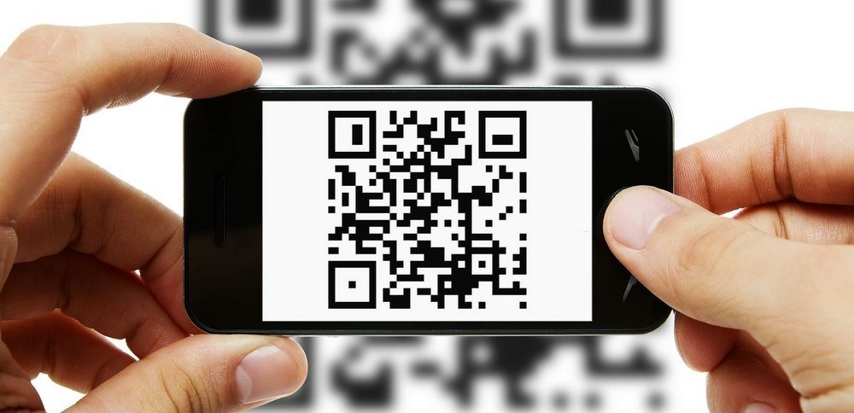

Objective
Introducing Online Ticket Booking System.
They can enjoy their trip without any suffering of crowd.
Tickets made at offline points will be based on facial recognition.
No man- work required to check the tickets.
Additionally, online customers are provided with Qr codes which saves time at entrance checking.

Slide 7
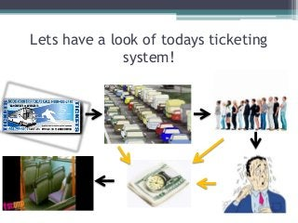
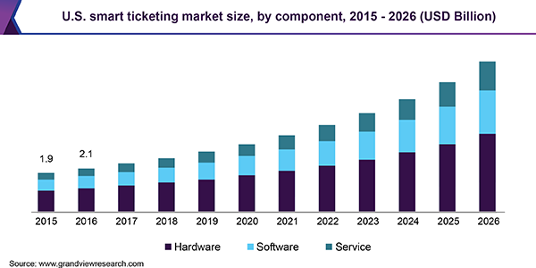
Scope

Slide 8
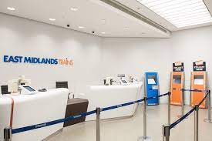
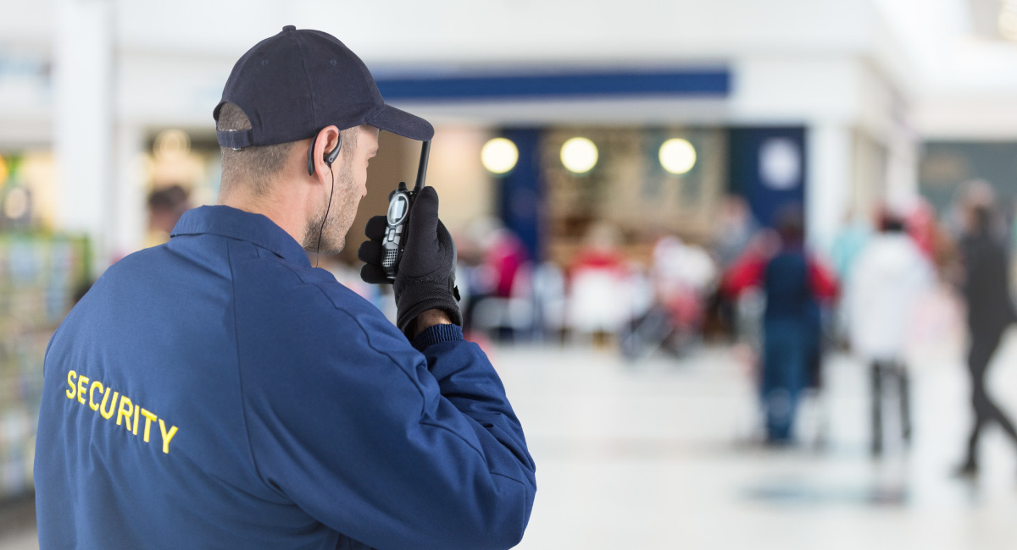

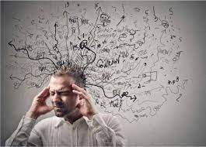
Proposed System
To develop a system of improved facilities.
This system can overcome all the limitations of the existing system.
Provides proper security and reduces the manual work.
Help the user to reduce the workload and mental conflict.

Slide 9
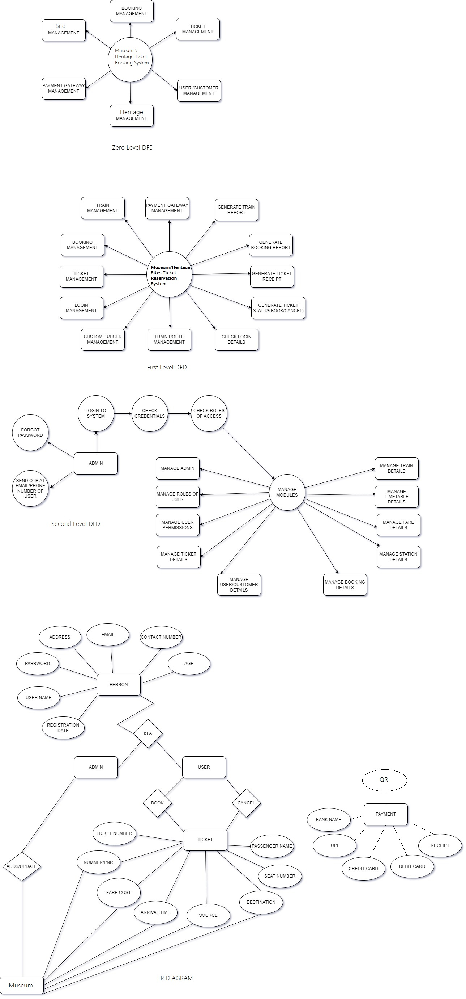
Use Case Modules

Slide 13
Work Flow

